Slide 1
Max Weber & understanding explanation W. Feuerhahn (CNRS, CAK)
Methodological Individualism and Contemporary Social Sciences
6-7.07.2023 (Sorbonne)

Slide 2
Understanding vs explanation: a dividing line?

Slide 3
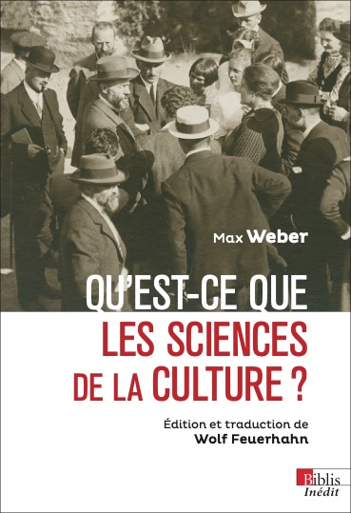
Roscher & Knies and the logical problems of historical economics (1903-06): an epistemological Battlefield

Slide 4
Weber & The Role of Methodology
"Methodology can never be more than a self-reflection on the means that have proved useful [bewährt] in [scientific] practice; and one does not need to be made explicitly aware of those means in order to produce useful work, just as one does not need to have knowledge of anatomy in order to walk 'correctly'"

Slide 5
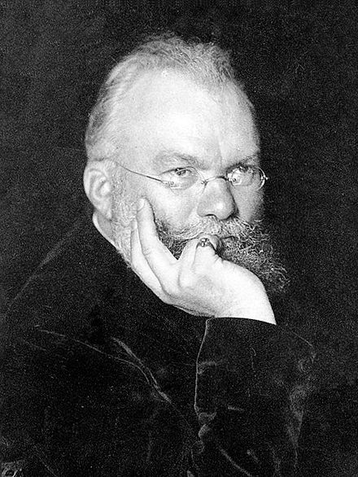
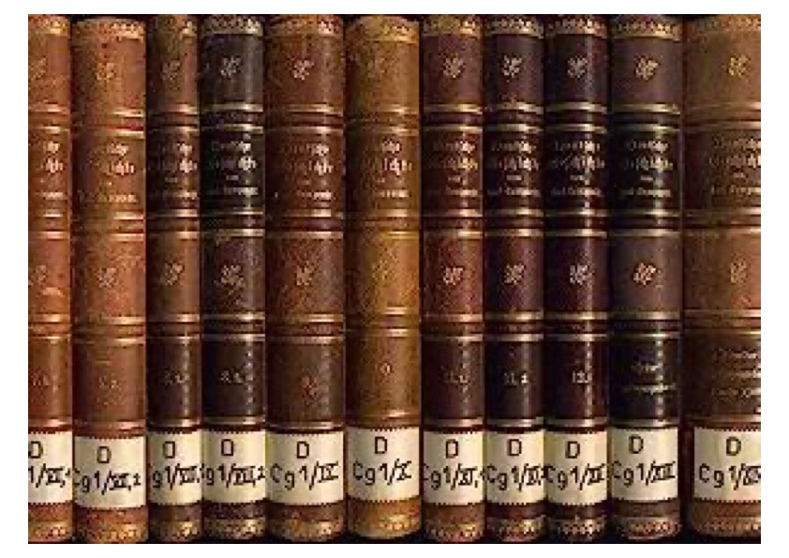
Lamprecht Controversy

Slide 6
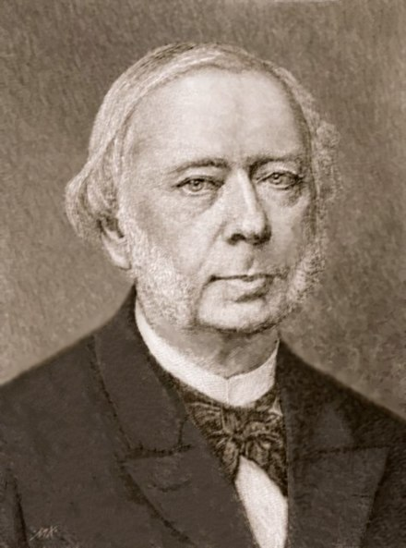
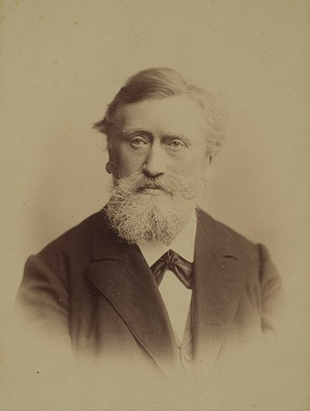
The « older school » of historical economics Wilhelm Roscher (1817-1894) & Karl Knies (1821-1898)

Slide 7
Wilhelm Windelband: Geschichte und Naturwissenschaft (1894)
"We are faced here with a purely methodological division of the sciences of experience [...]. The principle of division is the formal character of their goals of knowledge. Some seek universal laws, others particular historical facts. To use the language of formal logic: the aim of some is the general apodictic judgement, that of the others the singular and assertoric proposition. [...] Some are the nomological sciences [Gesetzeswissenschaften], others the sciences of the event [Ereigniswissenschaften]; the former teach what is always, the latter what was only once. If I may coin a new expression, I would say that scientific thought is nomothetic in the first case and idiographic in the second. "

Slide 8
Nomological sciences vs sciences of reality
Types of sciences Features | Nomological Sciences | Sciences of Reality
Task | Ordering infinite, extensive and intensive diversity with a system of concepts and laws that can be universally valid in the most absolute way possible | Knowing reality in its singularity and uniqueness = knowing the elements of reality which, in their individual specificity and because of it, appear to us as essential
Logical Ideal | Establish a system of universal laws and concepts | Separating what we consider 'characteristic' from what is contingent in individual phenomena
Specific Logical Means | Use of concepts whose extension is ever increasing and whose understanding is ever more restricted | Formation of relationship concepts with ever greater understanding and ever smaller extension
Specific Logical Product | Concepts about relationships with general value (laws) | Individual concepts about things with historical significance
Scope of Practice | Wherever what we consider essential in phenomena can be subsumed under a generic category | Wherever concrete reality interests us as such

Slide 9
Heinrich Rickert Kulturwissenschaft und naturwissenschaft (1899)
“We will find that we are usually only interested in realities that have no value or meaning that we can understand, and which we therefore regard as mere 'nature' in the sense already mentioned, in the sense of the sciences of nature in the logical sense; their singular configuration is not considered in its individuality, but commonly as a mere example of a more or less general concept. In contrast, the situation is quite different for cultural processes that are charged with value and meaning, and for events that we associate with culture because they represent its preliminary stages; our interest here is directed at the particular and the individual, as well as at their unique course. This is why we want to know them historically in an individualising way.”

Slide 10
Weber and Understanding explanation
"When we wish to interpret [human behaviour], we can, at least in principle, set ourselves the goal not make it ‘comprehensible’ [in the sense of] being 'possible' (that is to say: consistent with our nomological knowledge), but also to 'understand' it; that is to say, to uncover a concrete 'motive' that we can 're-experience' 'within ourselves', or a complex of such motives, to which we can impute [that behaviour] (with a degree of precision which will vary according to the nature of the source material)."

Slide 11
The boundaries of understanding explanation
“To be devoid of meaning is not identical with being lifeless or non-human; every artifact, such as for example a machine, can be understood only in terms of the meaning which its production and use have had or were intended to have; a meaning which may derive from a relation to exceedingly various purposes. Without reference to this meaning such an object remains wholly unintelligible. That which is intelligible or understandable about it is thus its relation to human action in the role either of means or of end; a relation of which the actor or actors can be said to have been aware and to which their action has been oriented. Only in terms of such categories is it possible to ‘understand’ objects of this kind”

