Slide 1
METHODOLOGICAL INDIVIDUALISM AND CONTEMPORARY SOCIAL SCIENCES Thursday and Friday, 6 &amp; 7, July 2023 Université Sorbonne 1, rue Victor Cousin 75005 Paris
From Methodological Cognitivism to Embodied Individualism
Riccardo Viale
Department of Economics Università di Milano Bicocca
Cognitive Insights Team, Herbert Simon Society

Slide 2
SNAPSHOT
1) Cognitive model of action of Methodological Cognitivism: Cartesian bias
2) The emergence of Wide Embodied Cognition
3) The limits of Decision Making
4) The Simonian alternative of Problem Solving
5) Enactive Problem Solving as the new model of social action EMBODIED INDIVIDUALISM

Slide 3
Raymond Boudon (1934-2013)

Slide 4
Boudon, R., & Viale, R., (2000). “Reason, cognition and society”. Mind & Society, 1,vol. 1.
If social theory has to be policy-relevant, it has to use a not too unrealistic “model of man”, even though any model represents a drastic simplification of the real world.
even simple beliefs or the most familiar types of behavior that we observe in everyday life can only be explained with difficulty by the two dominant models to which the familiar labels of Homo sociologicus and Homo oeconomicus are attached respectively. Redressing this situation may be one of the most challenging problems facing contemporary theory.
The point we would like to develop in a sketchy fashion is that sociological analysis needs a third model. We call it the rational model in the broad sense (RBS): it takes the form “the subject x had good, though possibly objectively invalid reasons for doing y, since ...”.

Slide 5
2012 2013

Slide 6
1990-2013 METHODOLOGICAL COGNITIVISM Principles:
Philosophy of Science: Causal Explanation (Reichenbach, Salmon, Mackie)
Methaphysics: Causal Realism (Lewis, Harman, Goldman)
Philosophy of Mind: Identity Theory (Paul and Patricia Churchland)
Epistemology: Naturalizing (Quine, Goldman, Stich)
Theory of Rationality: Bounded Rationality (J.Cohen, Boudon, Simon, Gigerenzer)

Slide 7
-Descriptive side: What Kind Of Cognitivism Was Dominant in the ‘90s ?
CARTESIAN MIND&BRAIN IN THE VAT
-Normative Side: What Theory of Rationality?
ECOLOGICAL BOUNDED RATIONALITY

Slide 8
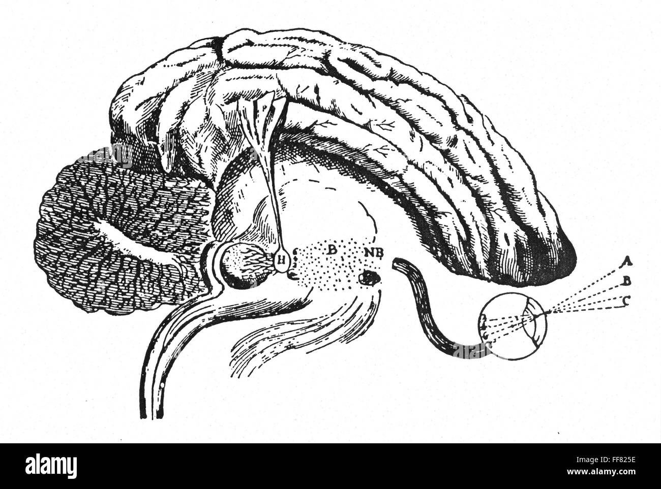
1) CARTESIAN MIND of COGNITIVISM : Beahavioral Economics (Simon and Kahneman & Tversky)
MIND IS MODULAR (Fodor, 1975)
METHAFOR OF SOFTWARE AND HARDWARE
(Putnam, 1975)
PROPERTY DUALISM (Davidson, 1970)
THINKING IS ONLY DIGITAL COMPUTATION
MENTAL REPRESENTATIONS ARE AMODAL (Descartes)
MIND AS A SANDWICH (Hurley, 1998): Mind is the tasty ham between insipid slices of action and senses

Slide 9
How is it possible to avoid the neural constraints? How to explain:
Neuropathology effects?
Neuropaharmacology effects?
Psychiatric disorders?

Slide 10
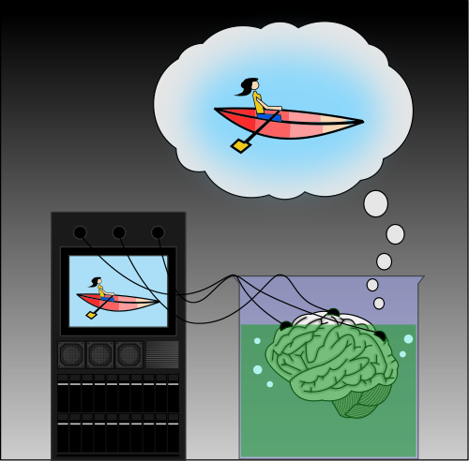
2) BRAIN IN THE VAT: neuroeco nomics (Camerer, Lowenstein)
Judgement And Decision Making Is Based On
Neuro Computations Judged By Formal Computational
Norms
Judgement And Decision Making Is Based On Amodal Representations: No Room For Modal Sensorial, Motor and Visceral Representations Of The Interaction With The Environment
Brain is detached from The Body and from the Environment: no embodiement and enactive adaptation
David Marr’s three levels of Cognition: COMPUTATIONAL, ALGORITHMIC, NEURAL

Slide 11
How is it possible to avoid the causal influences of:
Affective stimuli?
Sensorial imputs?
Motor and proprioceptive stimulations?
Visceral sensations?

Slide 12
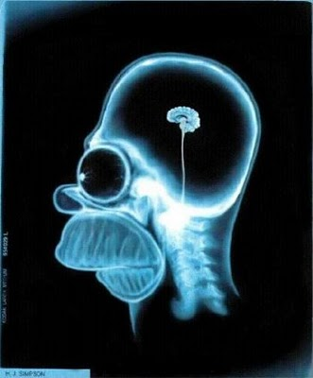
3) NARROW EMBODIED COGNITION (NEC)
NEC is in continuity with the Cartesian computational model
Goldman and Vignemont (2009) believe that the body plays
an important role through the brain modal representations
of its states.
Every body representation are formatted in the brain ruling out
any role of anatomy and body activity (actions and postures).
B-formats are purely internal to the brain. NEC has no interest in understanding the body interacting and embedded in the environment.

Slide 13
How is it possible not to consider that:
Body influences action without being represented in the brain?
People act in relation to possible answers from the environment (Gigson’s Affordances; Gallagher’s Enacting and Husserl’s «I can»)?
Situational context where the agent is embedded («Dasein»)?
The active information are not not only deposited in the brain but are extended in the environment?
Data coming from neuropsychology about the role of the entire body and of the environment to shape the action (embodied)?

Slide 14
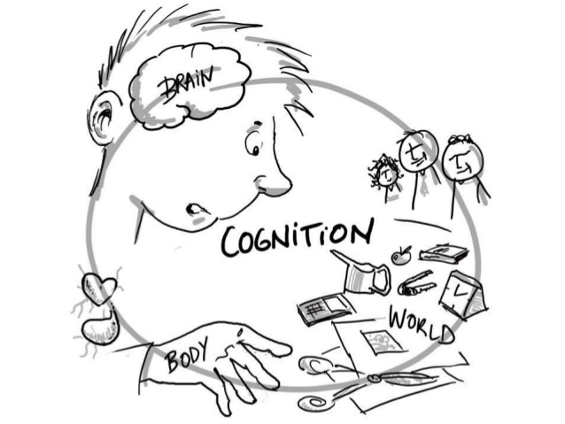
4) WIDE EMBODIED COGNITION (WEC) 4 E’s Embodied, Enacting, Extended, Embedded: ecological rationality
The psychological experience does not correspond only to the central computational cognitive functions but also to those of the body.
The extra-neural structural features of the body shape our cognitive experiences.
The way the body is made, its binocular vision, its vertical position, its peculiar rotation of the back and neck and its manual and movement skills are all characteristics that determine the perceptual and cognitive style.
The visceral stimuli that derive from the intestine act on an emotional, sensorial, perceptual and cognitive level: the phenomenon of gut feeling (Gigerenzer, 2007) or the concept of somatic marker (Damasio, 1994)
The body regulates the brain as much as the brain regulates the body.

Slide 16
New Question
What are the consequences of wide embodied cognition on methodological cognitivism?
What kind of theory of social action is implied by wide embodied cognition?
EMBODIED INDIVIDUALISM

Slide 17
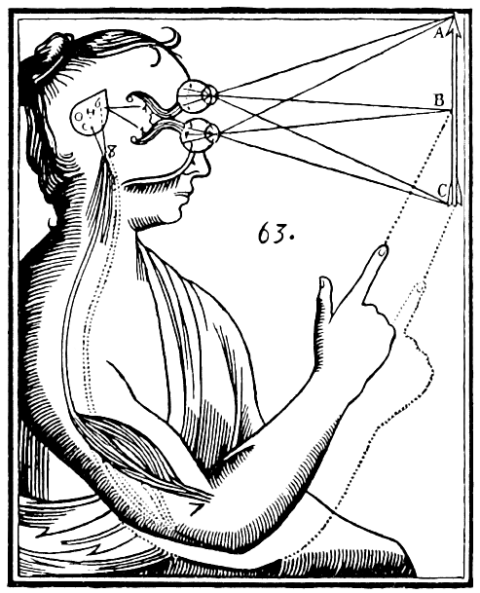
1) LIMITS OF DECISION MAKING PARADIGM
The cognitive psychology of decision precisely
reflects the conceptual structure of formal
subjective expected utility (SEU) theory
(Von Neumann and Morgenstern; Savage):
Cartesian Mind.
Ward Edwards, the founder of the psychology of decision making, began in the 1950s to carry out laboratory experiments on how people decide. His experiments have two fundamental characteristics:

Slide 18
Normative reference to SEU
the provisions of the SEU are set as a normative reference. The experimental work has the aim of evaluating when and how the human decision maker deviates from the requirements of the SEU.
The other feature is that the experiments are not carried out in real decision contexts, of everyday life, but in the abstract one of games, bets and lotteries. The informative characteristics typical of the real environment are completely neglected, such as uncertainty, complexity, poor definition of data, instability of phenomena, dynamic and interactive change with the decision maker, and so on.

Slide 19
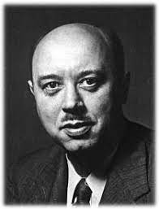
Pathological Statistical Intuitions from Abstract Descriptive One Shot Tests
Lejarraga and Hertwig (2021): Experimentation in decision psychology uses experiments that represent descriptions of statistical events (usually games) and not experiences on which a probabilistic judgment is asked.
They are not fullfilling the Brunswik (1943, 1953) features:
Ecological normal and representative design (abstract)
Discrete-continuous perspective (no learning)
Description-experience gap (no concretessness, no simplicity, no adjustment)

Slide 20
SEU Avatar Psychology of Decision Making (CARTESIAN MIND)
Analytical processing is the most important part of decision making. Processing probability and statistics is the most effective course in making decisions (Tversky & Kahneman, 1974).
Decision maker has to break the problem analyzing every piece of information available, the possible alternatives, the probabilities of their outcomes and the utility of the related consequences.
This decision model is supposed to be universal. It could be applied in any context of choice with little or much information, well structured or ill structured, in situations of risk and uncertainty.

Slide 21
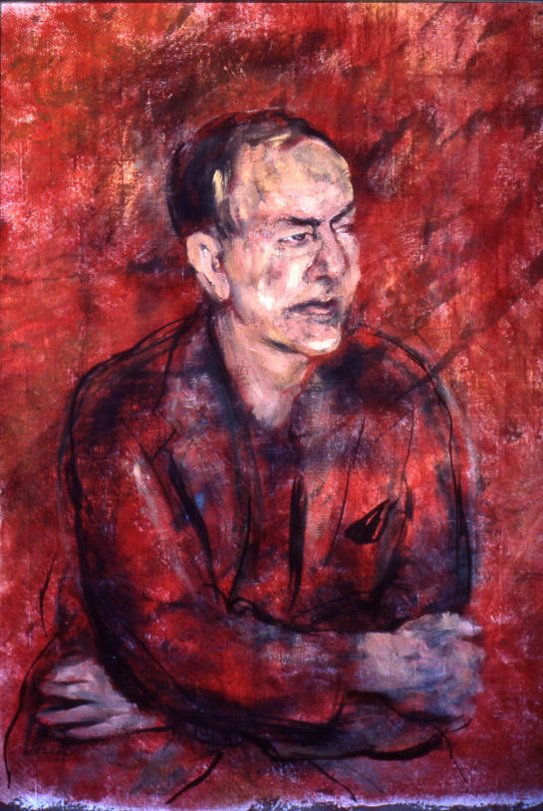
2) SIMON’S ALTERNATIVE OF PROBLEM SOLVING
When Simon introduces the concept of bounded rationality he does so by referring to behavior in public administration and industrial organizations. Unlike consumer behavior whose rationality has been evaluated in relation to the SEU theory, in organizations the behavior is evaluated above all at a routine or heuristic problem solving level.
Most of the problems in corporate strategy or governmental policy are as ill-structured as problems of architectural and engineering design or of scientific activity.

Slide 22
Cognitive Success (Viale, 2021)
SEU driven psychology deals solely with analytic judgements and choices
It is not interested in how to frame problems, set goals and develop heuristically a suitable course of action.
On the contrary, cognitive success in most human activities is based precisely on the successful completion of those problem-solving phases.
Problem solving is not computation of a decision based on an analytical data based prediction activity, but on a pragmatic recursive process made up of many heuristic attempts and related positive or negative feedback from the environment.

Slide 23
The metaphor of the ANT ON THE BEACH (Simon, 1981) : “Viewed as a geometric figure, the ant’s path is irregular, complex, hard to describe. But its complexity is really a complexity in the surface of the beach, not a complexity in the ant.” (Simon, 1981)
We can’t study individual’s want, need or value detached from the context of the environment that they’re in.
That environment shapes and influences their behavior in a recursive way.
The procedural rationality of the ant (finding through proper heuristics a suitable behavior on the beach) generates its substantial rationality (the adaptivity to the irregularity of the beach).

Slide 24
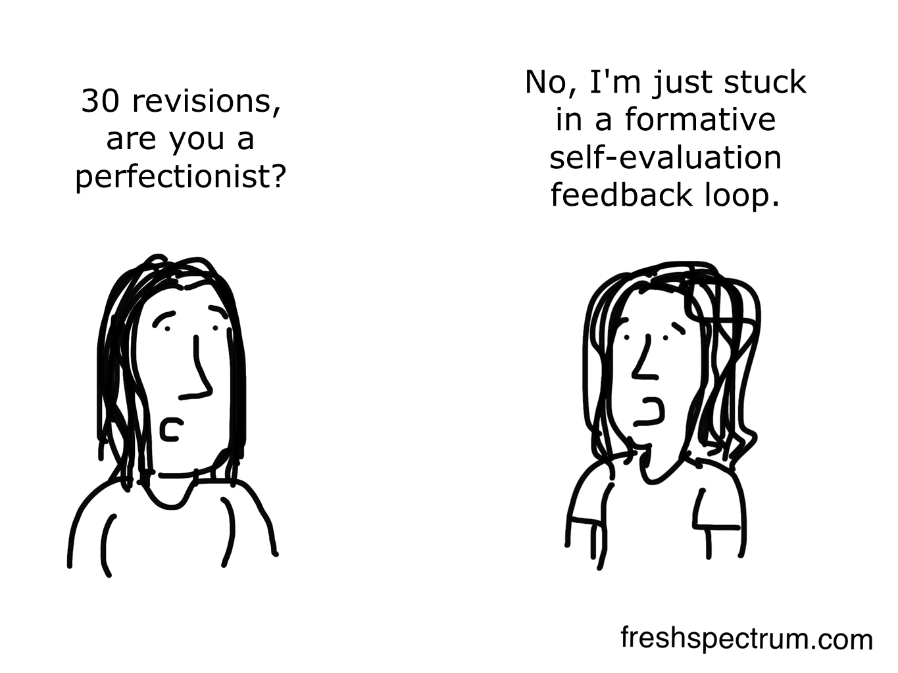
Environmental feed-backs are the most effective in modelling human actions in problem solving (Simon, 1981).
As in the industrial design the
social action follows the
logic of feedback.
The actions leading to the solution manipulate the world in a recursive feedback process: "state description" that describe the world as it is and "process description" that characterize the steps in manipulating the world through the heuristics to achieve the desired end.

Slide 25
3) ENACTIVE PROBLEM SOLVING: “portmanteau” between problem solving and enacting (Viale, 2023; Viale, Gallagher, and Gallese, 2023)
Problem solving needs the results from action (enaction): phenomenological feedbacks selectively direct us towards the final result.
Problem solving and enaction are part of the same phenomenon that I dub “enactive problem-solving”: it is a dynamic process based on pragmatic recursive attempts and related positive or negative feedback from the environmental affordances (or action possibilities).

Slide 26
The correspondence between action and solution of a problem conceptually bypasses the analytic phase of the decision and limits the role of symbolic representation.
The search of the solution corresponds to acting, in a recursive feedback process up to the final action
It is possible to construct the meaning of one's attempts at a solution and in the end to select the final solution only through the enacting interaction of the problem solver with environmental affordances.
Enactive problem solving is allowed by wide embodied cognition.

Slide 27
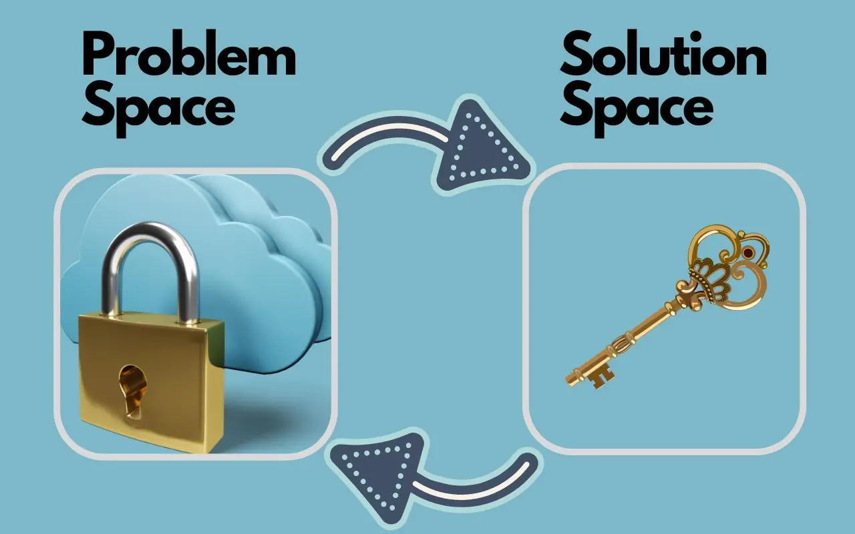
Social problem space is about social affordances
Simon (1970): «problem space is about the
possible situations to be searched in order to
find that situation which corresponds to the solution»
Dynamic interaction with the problem space to overcome the functional fixedness, as in the «candle problem» (Duncker, 1945; Macchi and Bagassi, 2021)
Similarity of social problem space scouting to the enactive interaction and coupling with the social environmental affordances.
Social problem space is about the possible solutions that are enacted by the social affordances («supportance»): Enactive Problem-Solving

Slide 28
Enacting
Problem Solving
Social Environmetal Affordances
Social Action
Feedbacks

Slide 29
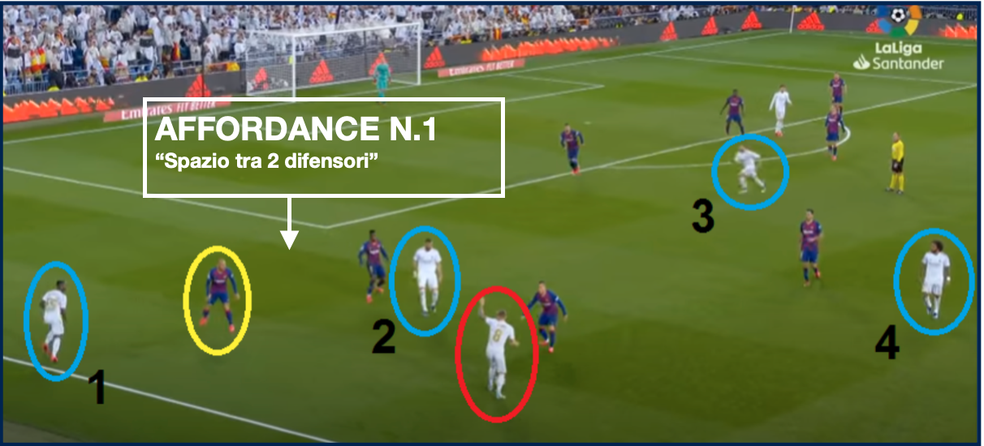
Social Affordances

Slide 30
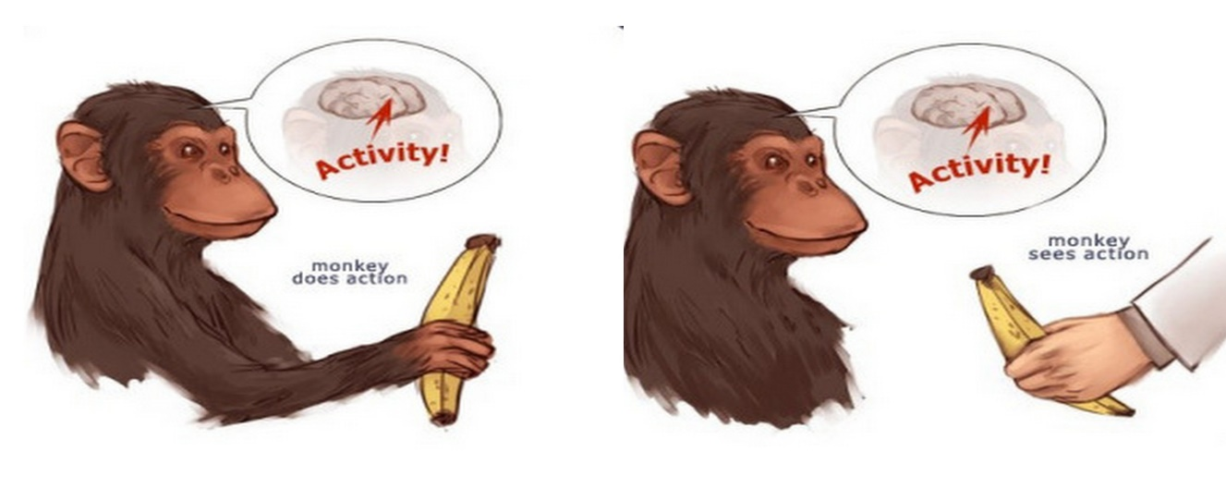
NEUROSCIENCE OF SOCIAL ENACTIVE PROBLEM SOLVING
Neural processes are dynamically coupled to non-neural bodily processes. Indeed, the explanatory model is brain–body-environment.
The discovery of ‘mirror neurons’ in macaque monkeys (Gallese et al., 1996; Rizzolatti et al., 1996), and then of similar mechanisms in humans (see Gallese et al., 2004), revealed the cognitive role of the motor system in social cognition, giving way to an embodied account of intersubjectivity, grounded on what the phenomenologist, Merleau-Ponty (2012), called intercorporeity

Slide 31
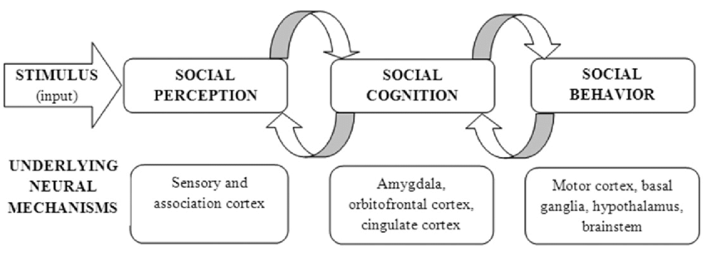
Haroush and Williams (2015) used a joint-decision paradigm to study mutual decisions in macaques. They revealed in the premotor dorsal region of the anterior cingulate cortex (dACC) neurons encoding the monkey’s own decision to cooperate intermingled with neurons encoding the opponent monkey’s decisions when they were yet unknown. The problem space includes a reserved slot for the anticipated decisions and actions of the other agent.
Another recent study by Grabenhorst et al. (2019) showed that macaques’ amygdala neurons derive object values from conspecifics’ behaviour observation (that is, from the other agents’ observed actions towards a particular object) which the system then uses to anticipate a partner monkey’s decision process.

Slide 32
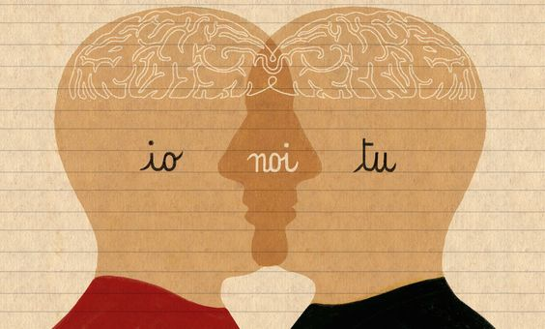
As Bonini et al. (2023) recently argued, “Our recent perspective emphasizes the role of agent-based coding as a means of linking sensory information about others (i.e., via othertype neurons) to one’s own motor plans (i.e., self-type neurons). The inherently predictive nature of the motor and visceromotor systems, which hosts this neural machinery, enables the flexible preparation of responses to others depending on social and nonsocial contexts.”

Slide 33
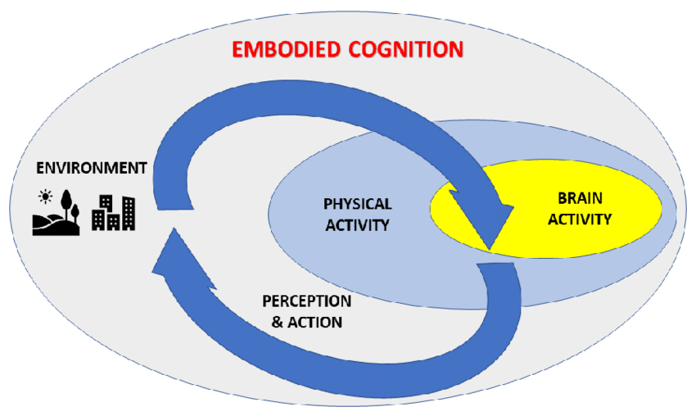
Our own planning and problem solving involve behavioural responses that depend on the behaviours of others. To put it simply, it is not the brain per se, but the brain–body, by means of its interactions with the world of which it is part, that enacts our cognitive capacities.
The proper development of this functional architecture of brain–body-environment scaffolds the more cognitively sophisticated social cognitive (including linguistic and conceptual) abilities that constitutes our rationality.

Slide 34
Conclusion: EMBODIED INDIVIDUALISM
Descriptive Side:
Social action is described by enactive problem solving
Enactive Problem Solving is explained by Wide Embodied Cognition driven Heuristics
Normative Side:
Social Action is assessed by Ecological Bounded Rationality
Ecological Bounded Rationality is described by the adaptive success in social task (accuracy, frugality, speed, simplicity of the solutions by enactive problem solving)

Slide 35
THANKS FOR YOUR EMBODIED BOUNDED ATTENTION and New Readings related to Embodied Cognitive Individualism Gigerenzer, G., Shabnam, M., and Viale, R. Companion to Herbert Simon. Elgar (2023) Viale, R., Gallagher, S., and Gallese, V. «BOUNDED RATIONALITY, ENACTIVE PROBLEM SOLVING, AND THE NEUROSCIENCE OF SOCIAL INTERACTION”. Frontiers in Psychology 14:1152866. doi: 10.3389/fpsyg.2023.1152866 (2023)
MIT Press (2022) Routledge (2021)

